Slide 1

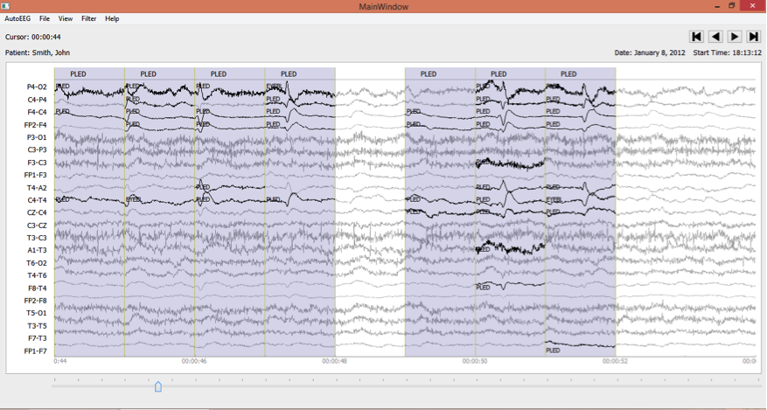
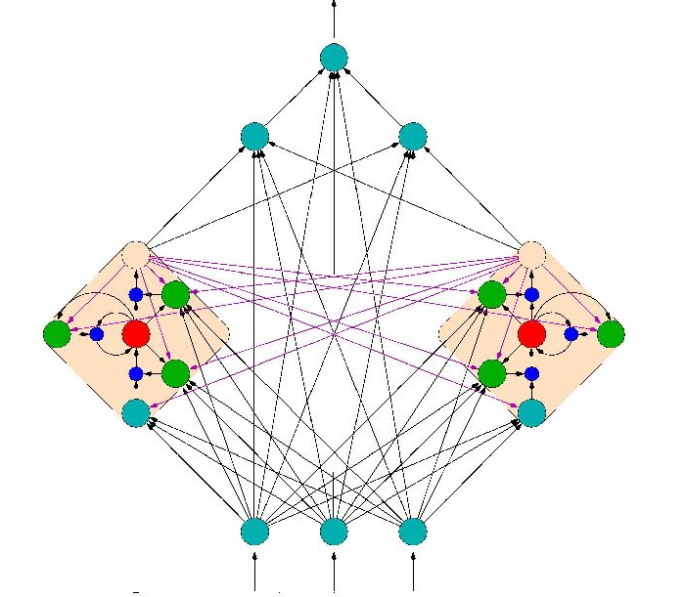

EEG Classification Using
Long Short-Term Memory Recurrent Neural Networks
Meysam Golmohammadi
meysam@temple.edu
Neural Engineering Data Consortium
College of Engineering
Temple University
February 2016
Notes:
Good morning every one, it’s great to see you all here and thank you for coming. My name is Meysam and it's my honor to work with Dr. Picone as my advisor. Please let me welcome Dr. Chitturi from Statistics Department. I also would like to take this moment as a chance to express my gratitude to Dr. Won and Dr. Obeid who supported my entrance in PhD program as first place. Today I am going to be talking about long short term memory recurrent neural networks and their potential for EEG classification task.

Slide 2
Introduction
Recurrent Neural Networks
Long Short-Term Memory Networks
Deep Recurrent Neural Networks
Deep Bidirectional Long Short-Term Memory Networks
EEG Classification Using Deep Learning
Notes:
I start from scratch with Recurrent Neural Networks. Then I’ll explain Long Short-Term Memory Networks. After that I will continue with Deep Recurrent Neural Networks. Then I will introduce you to Deep Bidirectional Long Short-Term Memory Networks. And finally I’ll wrap up the discussion with an overview on EEG classification using deep learning.

Slide 3
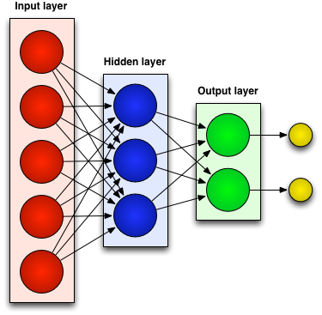
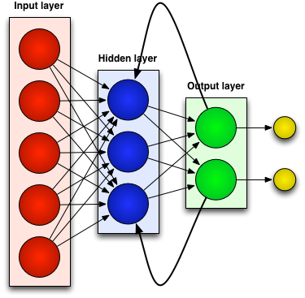
Neural Networks
Generally there are two kinds of neural networks:
Feedforward Neural Networks:
connections between the units do not form a cycle
Recurrent Neural Network:
connections between units form cyclic paths
Notes:
In recent years, neural networks composed of multiple layers, which are often termed as Deep Learning, have emerged as a powerful machine learning approach.
A feedforward neural network is an artificial neural network where connections between the units do not form a cycle. In other word in feedforward networks processing of information is piped through the network from input layers to output layers.
In contrast, a recurrent neural network (RNN) is an artificial neural network where connections between units form cyclic paths.

Slide 4
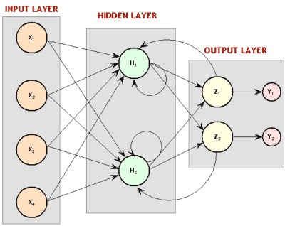
Recurrent Neural Network (RNN)
Recurrent since they receive inputs, update the hidden states depended on the previous computations, and make predictions for every element of a sequence.
We can consider RNNs as a neural network with memory as they keep information of what has been processed so far.
RNNs are very powerful dynamic systems for sequence tasks such as speech recognition or handwritten recognition as they can maintain a state vector that implicitly contains information about the history of all the past elements of the sequence.
Notes:
RNNs are called recurrent …
We can consider RNNs as …
RNNs are very …

Slide 5
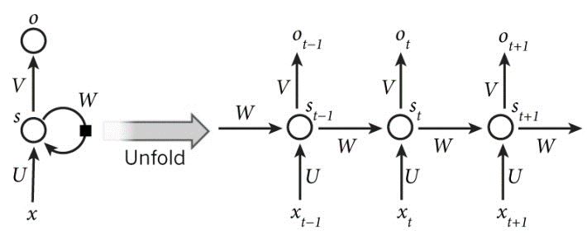
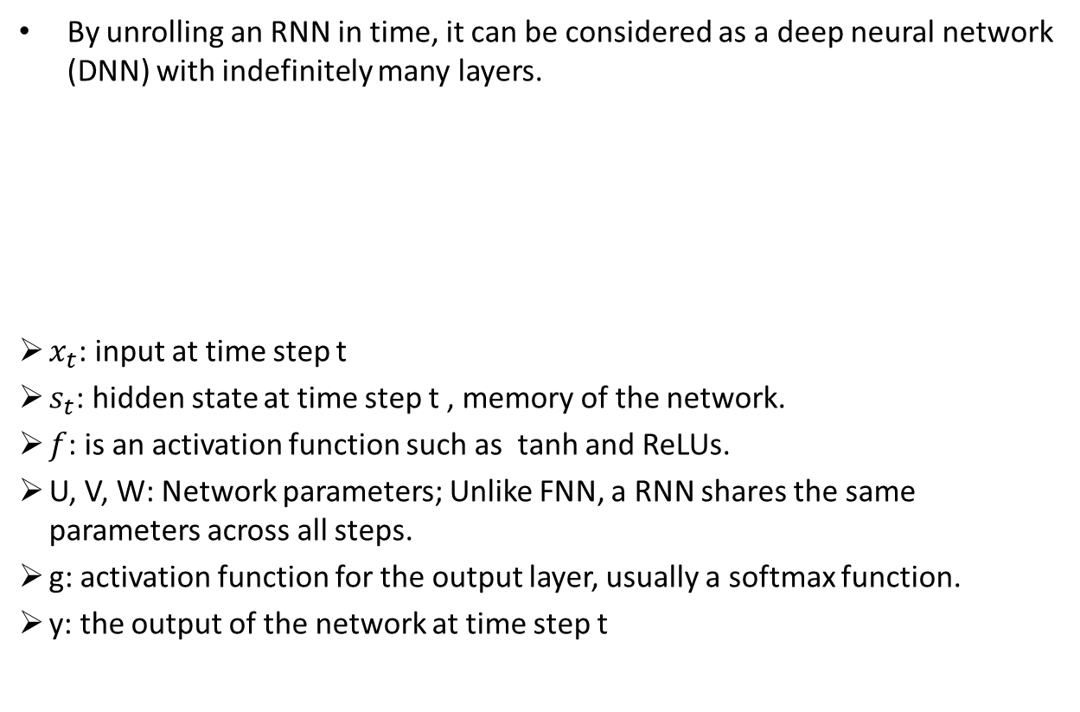
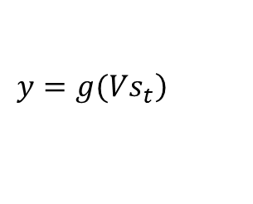
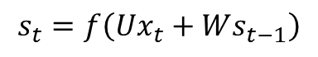
RNN unrolled in time
By unrolling an RNN in time, it can be considered as a deep neural network (DNN) with indefinitely many layers.
$x_{t}$: input at time step t
$s_{t}$: hidden state at time step t , memory of the network.
$f$: is an activation function such as tanh and ReLUs.
U, V, W: Network parameters; Unlike FNN, a RNN shares the same parameters across all steps.
g: activation function for the output layer, usually a softmax function.
y: the output of the network at time step t
$$s_{t}=f\left(Ux_{t}+Ws_{t−1}\right)$$
$$\left.y=g(Vs_{t}\right)$$
Notes:
In these equations $x_{t}$is the input at time step t. $S_{t}$ is the hidden state at time step t which is in fact the memory of the network and it is calculated based on the input at the current step and the previous hidden state. $f$ is a activation function which transforms the inputs of the layer into its outputs and allows us to fit nonlinear hypotheses. Common choices for $f$ are tanh and ReLUs. $S_{−1}$ which is required to initialize the first hidden state is typically set to all zeroes. The output of the network is $y$ which is calculated by a nonlinear function of matrix multiplication of V and $S_{t}$. In fact this nonlinear function, g, is the activation function for the output layer and usually it is the softmax function. It is simply a way to convert raw scores to probabilities. Unlike feed forward neural networks, which have different parameters at each layer, a RNN shares the same parameters (U, V, W in Eq. 2.1 and Eq. 2.2) across all steps.
rectified linear unit (ReLU)

Slide 6
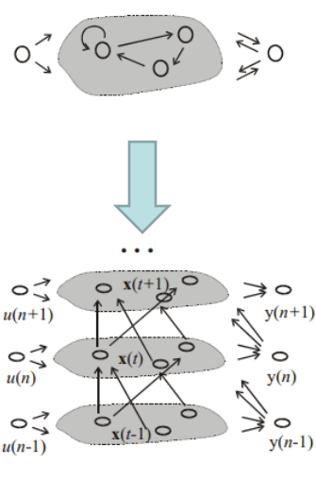
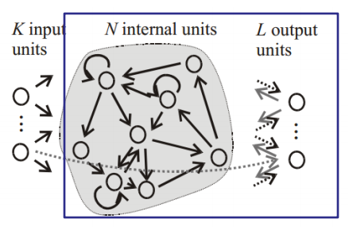
RNN training
There are different approaches for training of RNNs:
Back-Propagation Through Time (BPTT):
Unfolding RNN in time and using the extended version of backpropagation which is used to train feedforward neural network.
Real-Time Recurrent Learning (RTRL):
Computing the error gradient and update weights for each time step.
Extended Kalman Filtering (EKF):
a set of mathematical equations that provides an efficient computational means to estimate the state of a process, in a way that minimizes the mean of the squared error on linear system.
BPTT
RTRL
Notes:
The feedforward neural networks can be trained by backpropagation algorithm. In RNNs, a slightly modified version of this algorithm called Backpropagation through Time (BPTT) is used to train the network.

Slide 7
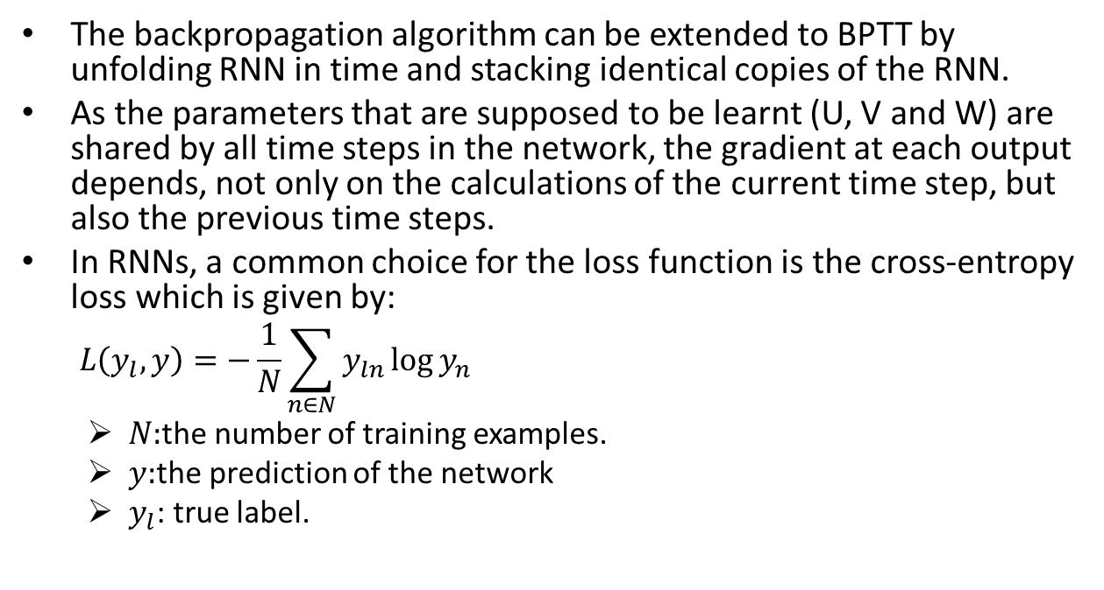
Back-Propagation Through Time
The backpropagation algorithm can be extended to BPTT by unfolding RNN in time and stacking identical copies of the RNN.
As the parameters that are supposed to be learnt (U, V and W) are shared by all time steps in the network, the gradient at each output depends, not only on the calculations of the current time step, but also the previous time steps.
In RNNs, a common choice for the loss function is the cross-entropy loss which is given by:
$$L\left(y_{l},y\right)=−\frac{1}{N}\sum_{n∈N}{y_{ln}\log{y_{n}}}$$
$N:$the number of training examples.
$y:$the prediction of the network
$y_{l}$: true label.
Notes:
The backpropagation algorithm can be extended to BPTT by unfolding RNN in time and stacking identical copies of the RNN.
As the parameters that are supposed to be learnt (U, V and W) are shared by all time steps in the network, the gradient at each output depends not only on the calculations of the current time step, but also the previous time steps.

Slide 8
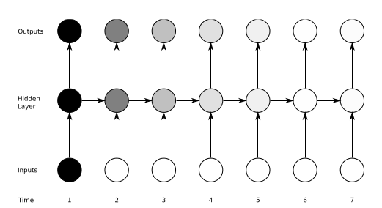
Vanishing Gradient Problem
Definition: The influence of a given input on the hidden layer, and therefore on the network output, either decays or blows up exponentially as it pipes through RNN.
In practice, the range of contextual information that standard RNNs can access are limited about 10 time steps between relevant input and target events.
Solution: LSTM networks.
Notes:
While RNNs are powerful structures, they are hard to train.
One of the main reason is “vanishing gradient problem” which explored in depth by Bengio and it refers to
They found that in theory RNNs can make use of information in arbitrarily long sequences, but in practice they are limited to looking back only a few steps.
This means in practice …
The most successful solution is to use Long Short-Term Memory (LSTM) which will be introduced in next chapter.

Slide 9
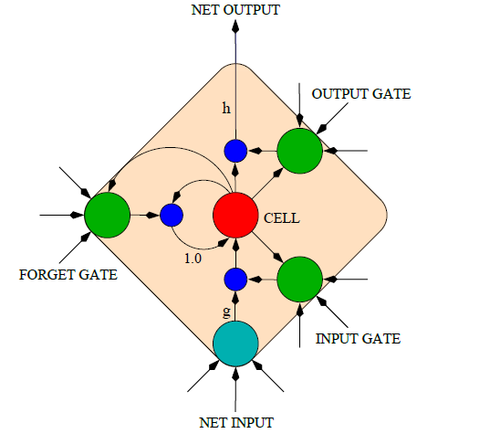
LONG SHORT-TERM MEMORY (LSTM)
LSTM: A special kind of RNN architecture, capable of learning long-term dependencies.
LSTM can learn to bridge time intervals in excess of 1000 steps.
LSTM networks can outperforms alternative RNNs and Hidden Markov Models (HMM):
Speech Recognition :17.7% phoneme error rate on TIMIT natural speech dataset.
Winner of the ICDAR handwriting competition for the best known results in handwriting recognition.
This is achieved by multiplicative gate units learn to open and close access to the constant error flow.
LSTM Memory Cell
Notes:
Long Short Term Memory networks are a special kind …

Slide 10
Memory Cell in LSTM
LSTM networks introduce a new structure called a memory cell.
Each memory cell contains four main elements:
Input gate
Forget gate
Output gate
Neuron with a self-recurrent
These gates allow the cells to keep and access information over long periods of time.
LSTM Memory Cell

Slide 11
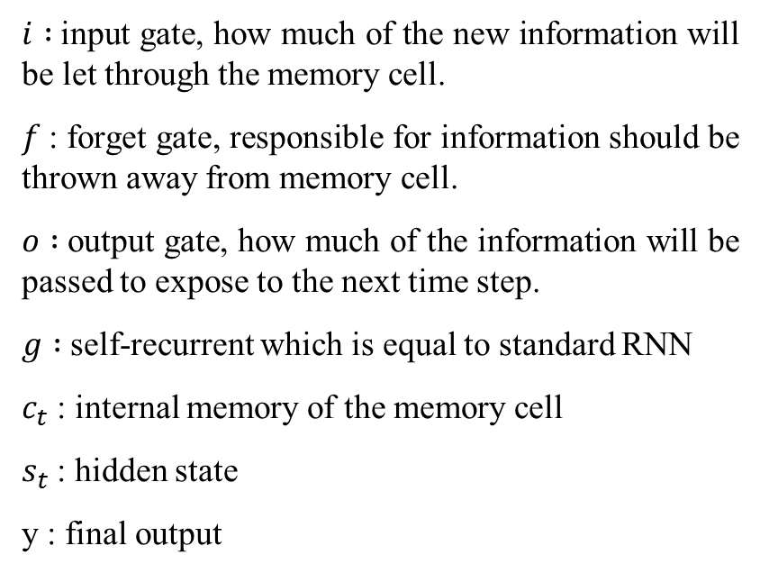
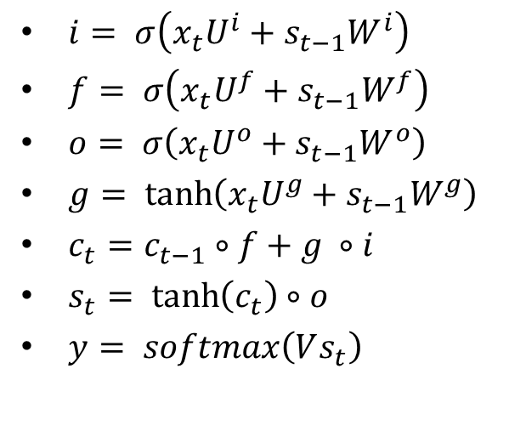
LSTM Equations
$i :$input gate, how much of the new information will be let through the memory cell.
$f$: forget gate, responsible for information should be thrown away from memory cell.
$o :$output gate, how much of the information will be passed to expose to the next time step.
$g :$self-recurrent which is equal to standard RNN
$c_{t}$: internal memory of the memory cell
$s_{t}$: hidden state
y : final output
$i= σ\left(x_{t}U^{i}+s_{t−1}W^{i}\right)$
$f= σ\left(x_{t}U^{f}+s_{t−1}W^{f}\right)$
$o= σ\left(x_{t}U^{o}+s_{t−1}W^{o}\right)$
$g= \tanh\left(x_{t}U^{g}+s_{t−1}W^{g}\right)$
$c_{t}=c_{t−1}∘f+g ∘i$
$s_{t}= \tanh\left(c_{t}\right)∘o$
$y= softmax\left(Vs_{t}\right)$

Slide 12
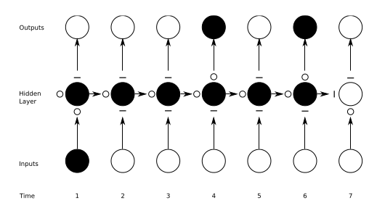
Preserving the information in LSTM
A schematic of an LSTM unrolled in time to show how LSTM can preserve the information.
The input, forget, and output gate activations are respectively displayed below, to the left and above the memory block. For simplicity, the gates are either entirely open (‘O’) or entirely closed (‘—’).
Traditional RNNs: a special case of LSTMs, If we set the input gate all ones (passing all of the new information), the forget gate all zeros (forgetting all of the previous memory) and the output gate to all ones (exposing the whole memory).

Slide 13
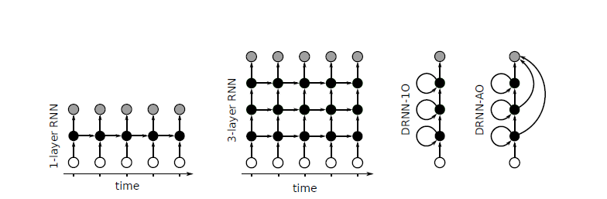
DEEP RECURRENT NEURAL NETWORKS (DRNN)
Standard RNN: the information only passes through one layer of processing before going to the output.
In sequence tasks we usually need to process the information at several time scales.
DRNN: a combination of the concepts of deep neural networks (DNN) with RNNs.
By stacking RNNs, every layer is an RNN in the hierarchy that receives the hidden state of the previous layer as input.
Processing of different time scales at different levels, and therefore a temporal hierarchy will be created.
Notes:
One potential disadvantage of traditional RNN which explained in the first part of the presentation is that,
In this part a structure called deep recurrent neural network(DRNN) will be explained which is basically
In DRNN by stacking RNNs,
In this way processing

Slide 14
DRNN-1O vs. DRNN-AO
Two variants of DRNN structures:
DRNN-1O: the output will be computed just based on the hidden state of the last layer
DRNN-AO: the output will be the combination of the hidden states of the all layers.
DRNN-AO has two great advantageous in comparison with DRNN-1O:
Using BPTT for DRNN-AO, the error will propagate from the top layer down the hierarchy without attenuating of magnitude and as a result the system will be trained effectively.
It gives us the ability to evaluate the impact of each layer in solving the task by leaving out an individual layer’s contribution.
Notes:
Different variations of the structures of DRNNs are depicted in this slide.
In this picture connection matrices are shown by arrows.
Also input frames, hidden states, and output frames are represented by white,black and grey circles respectively.
In both of these structures the looped arrows represent the recurrent weights.

Slide 15
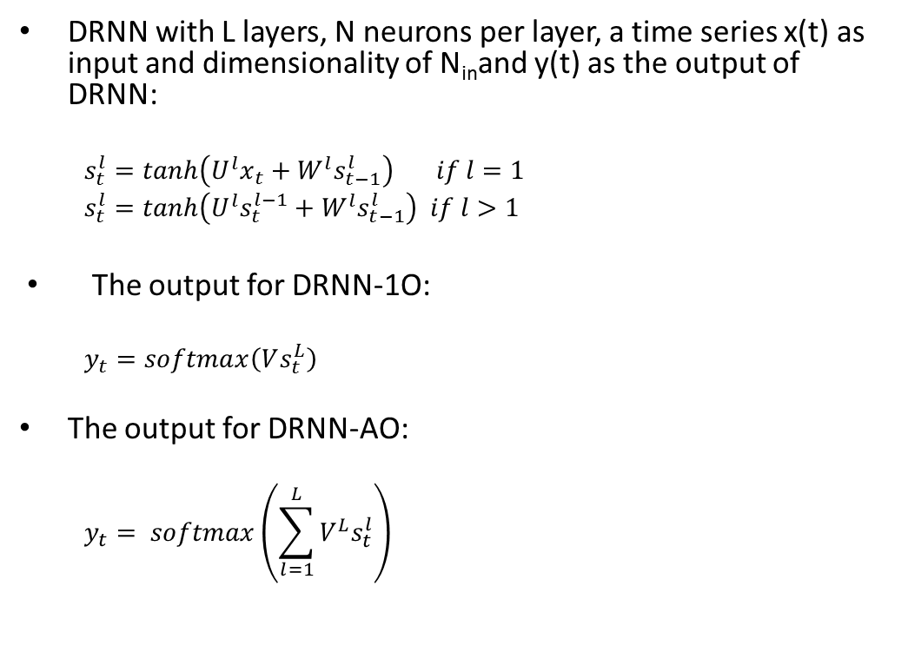
DRNN Equations
DRNN with L layers, N neurons per layer, a time series x(t) as input and dimensionality of N­_{in}and y(t) as the output of DRNN:
$$s_{t}^{l}=tanh\left(U^{l}x_{t}+W^{l}s_{t−1}^{l}\right) if l=1$$
$$s_{t}^{l}=tanh\left(U^{l}s_{t}^{l−1}+W^{l}s_{t−1}^{l}\right) if l>1$$
The output for DRNN-1O:
$$y_{t}=softmax\left(Vs_{t}^{L}\right)$$
The output for DRNN-AO:
$$y_{t}= softmax\left(\sum_{l=1}^{L}{{V^{L}s}_{t}^{l}}\right)$$

Slide 16
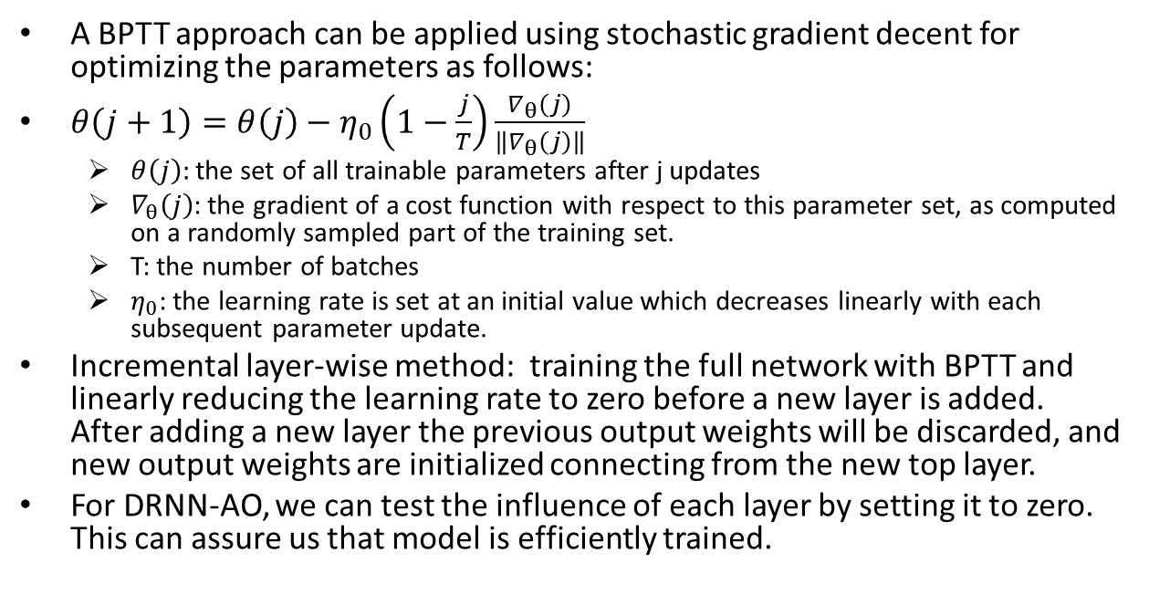
DRNN training
A BPTT approach can be applied using stochastic gradient decent for optimizing the parameters as follows:
$θ\left(j+1\right)=θ\left(j\right)−η_{0}\left(1−\frac{j}{T}\right)\frac{∇_{θ}\left(j\right)}{\left\|∇_{θ}\left(j\right)\right\|}$
$θ\left(j\right):$the set of all trainable parameters after j updates
$∇_{θ}\left(j\right)$: the gradient of a cost function with respect to this parameter set, as computed on a randomly sampled part of the training set.
T: the number of batches
$η_{0}$: the learning rate is set at an initial value which decreases linearly with each subsequent parameter update.
Incremental layer-wise method: training the full network with BPTT and linearly reducing the learning rate to zero before a new layer is added. After adding a new layer the previous output weights will be discarded, and new output weights are initialized connecting from the new top layer.
For DRNN-AO, we can test the influence of each layer by setting it to zero. This can assure us that model is efficiently trained.
Notes:
In order to train a DRNN, …

Slide 17
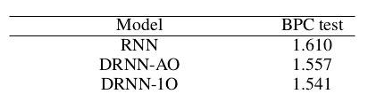
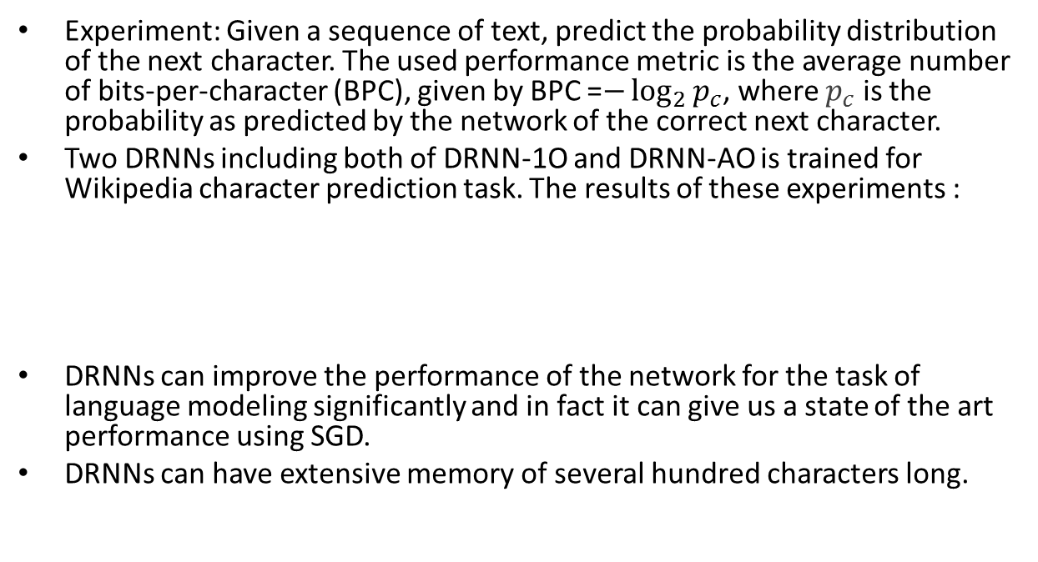
Performance of DRNNs
Experiment: Given a sequence of text, predict the probability distribution of the next character. The used performance metric is the average number of bits-per-character (BPC), given by BPC =$−\log_{2}{p_{c}}$, where $p_{c}$ is the probability as predicted by the network of the correct next character.
Two DRNNs including both of DRNN-1O and DRNN-AO is trained for Wikipedia character prediction task. The results of these experiments :
DRNNs can improve the performance of the network for the task of language modeling significantly and in fact it can give us a state of the art performance using SGD.
DRNNs can have extensive memory of several hundred characters long.

Slide 18
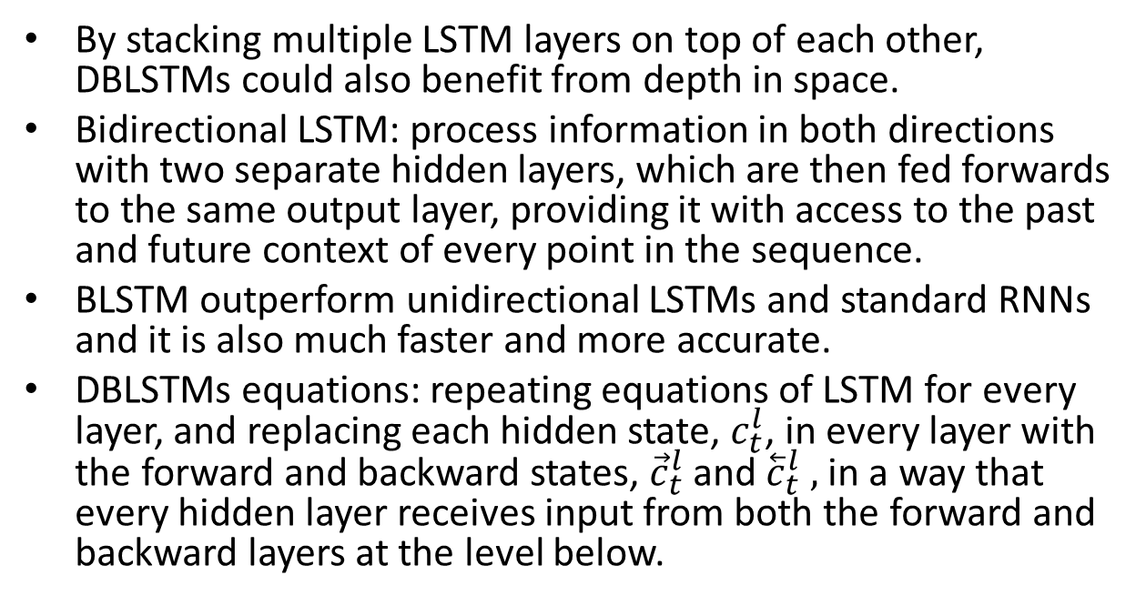
DEEP BIDIRECTIONAL LONG SHORT-TERM MEMORY (DBLSTM)
By stacking multiple LSTM layers on top of each other, DBLSTMs could also benefit from depth in space.
Bidirectional LSTM: process information in both directions with two separate hidden layers, which are then fed forwards to the same output layer, providing it with access to the past and future context of every point in the sequence.
BLSTM outperform unidirectional LSTMs and standard RNNs and it is also much faster and more accurate.
DBLSTMs equations: repeating equations of LSTM for every layer, and replacing each hidden state, $c_{t}^{l}$, in every layer with the forward and backward states, ${\vec{c}}_{t}^{l}$and ${\overset{⃖}{c}}_{t}^{l} ,$in a way that every hidden layer receives input from both the forward and backward layers at the level below.
Notes:
One of the greatest disadvantageous of RNN and LSTM structures that were introduced in part 1 and 2, is that they are processing information just based on the previous context.
In a lot of application including speech recognition, we prefer another structure called bidirectional LSTM (BLSTM) which can …
BLSTMs contain two separate hidden layers, one of them processes the input sequence forwards, while the other processes it backwards. Both hidden layers are connected to the same output layer, providing it with access to the past and future context of every point in the sequence.

Slide 19
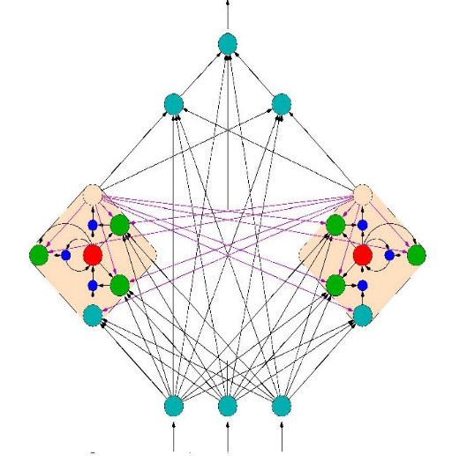
DBLSTM training and regularization
End-to-end training methods :
Connectionist Temporal Classification (CTC).
RNN Transducer.
Regularization:
early stopping : monitoring the model’s performance on a validation set.
weight noise : adding Gaussian noise to the network weights during training. Weight noise was added once per training sequence, rather than at every time step.

Slide 20
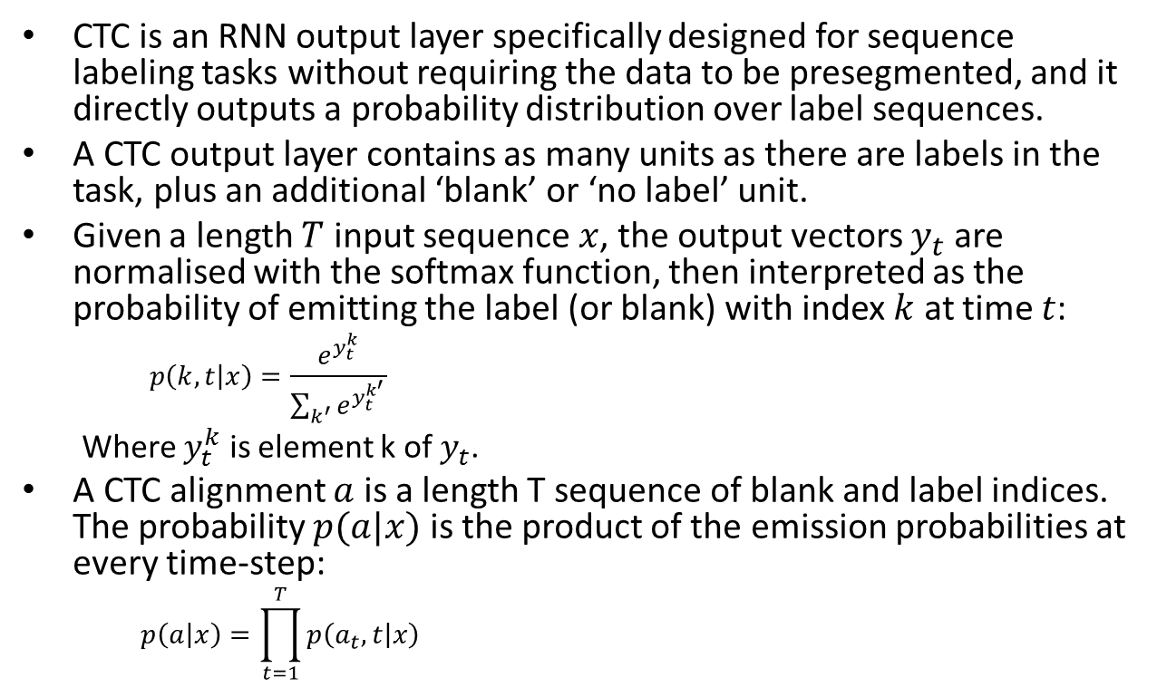
Connectionist Temporal Classification (CTC)
CTC is an RNN output layer specifically designed for sequence labeling tasks without requiring the data to be presegmented, and it directly outputs a probability distribution over label sequences.
A CTC output layer contains as many units as there are labels in the task, plus an additional ‘blank’ or ‘no label’ unit.
Given a length $T$ input sequence $x$, the output vectors $y_{t}$ are normalised with the softmax function, then interpreted as the probability of emitting the label (or blank) with index $k$ at time $t$:
$$p\left(k,t | x\right)=\frac{e^{y_{t}^{k}}}{\sum_{k^{′}}{e^{y_{t}^{k^{′}}}}}$$
Where $y_{t}^{k}$ is element k of $y_{t}$.
A CTC alignment $a$ is a length T sequence of blank and label indices. The probability $p(a|x)$ is the product of the emission probabilities at every time-step:
$$p\left(a | x\right)=\prod_{t=1}^{T}{p\left(a_{t},t | x\right) }$$

Slide 21
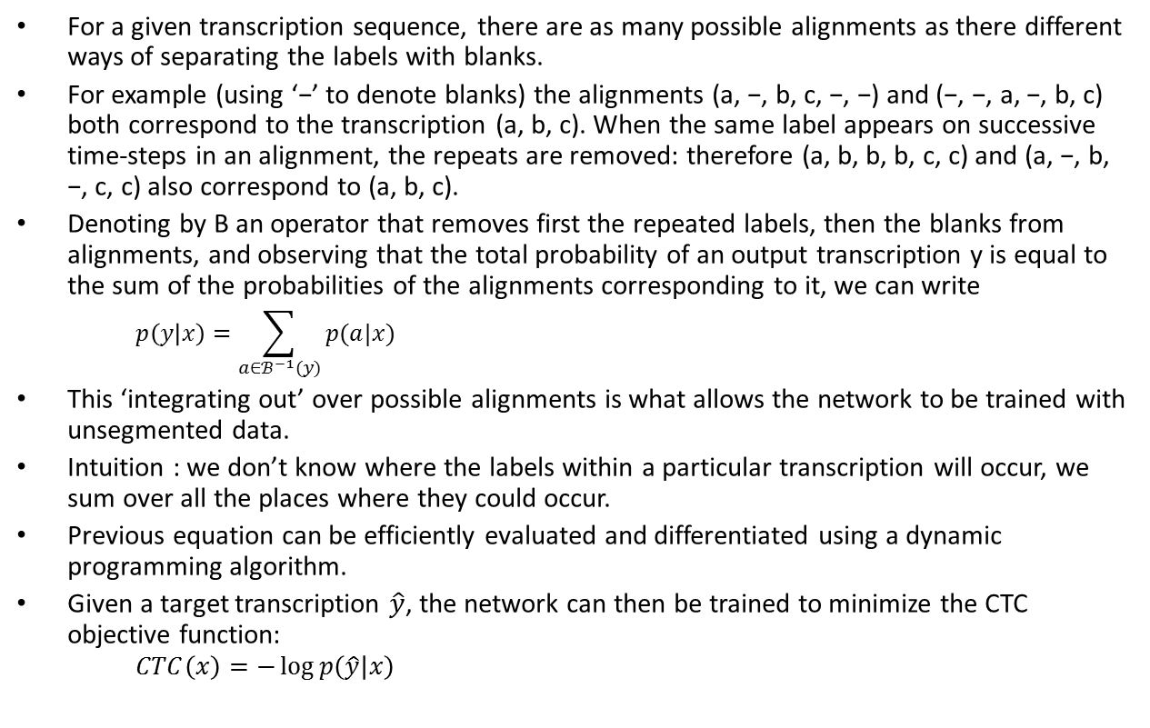
Connectionist Temporal Classification (CTC)
For a given transcription sequence, there are as many possible alignments as there different ways of separating the labels with blanks.
For example (using ‘−’ to denote blanks) the alignments (a, −, b, c, −, −) and (−, −, a, −, b, c) both correspond to the transcription (a, b, c). When the same label appears on successive time-steps in an alignment, the repeats are removed: therefore (a, b, b, b, c, c) and (a, −, b, −, c, c) also correspond to (a, b, c).
Denoting by B an operator that removes first the repeated labels, then the blanks from alignments, and observing that the total probability of an output transcription y is equal to the sum of the probabilities of the alignments corresponding to it, we can write
$$p\left(y | x\right)=\sum_{a∈ℬ^{−1}(y)}{p(a|x)}$$
This ‘integrating out’ over possible alignments is what allows the network to be trained with unsegmented data.
Intuition : we don’t know where the labels within a particular transcription will occur, we sum over all the places where they could occur.
Previous equation can be efficiently evaluated and differentiated using a dynamic programming algorithm.
Given a target transcription $\hat{y}$, the network can then be trained to minimize the CTC objective function:
$$CTC\left(x\right)=−\log{p\left(\hat{y} | x\right)}$$

Slide 22
RNN transducer
A combination of a CTC network with a separate DBLSTM that predicts each phoneme given the previous one.
Unlike CTC which is a an acoustic-only model, RNN Transducer can integrate acoustic and linguistic information during a speech recognition task and yields a jointly trained acoustic and language model.
While CTC predicts an output distribution at each input time step, an RNN transducer determines a separate distribution P(k|t,u) for every combination of input timestep t and output timestep u.
RNN transducer is using two networks:
Transcription network: scans the input sequence and outputs the sequence of transcription vectors.
Prediction network: scans the output sequence and outputs the prediction vector sequence.
RNN transducers can be decoded with beam search to yield an n-best list of candidate transcriptions.

Slide 23
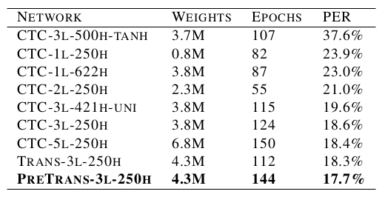
DBLSTM performance
phoneme recognition experiments on the TIMIT corpus.
Bidirectional LSTM was used for all networks except CTC-3l-500h-tanh, which had tanh units instead of LSTM cells, and CTC-3l-421h-uni where the LSTM layers were unidirectional.
LSTM works much better than tanh for this task.
bidirectional LSTM has a slight advantage over unidirectional LSTM.
depth is more important than layer size.

Slide 24
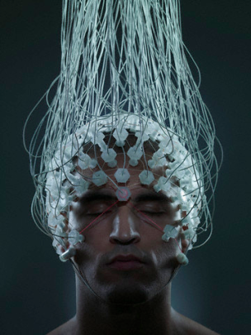
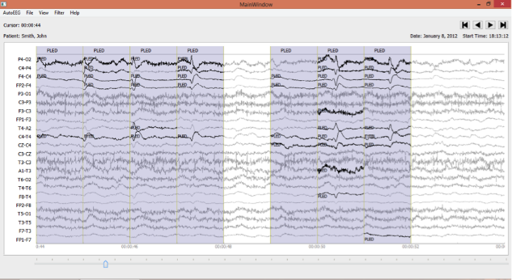
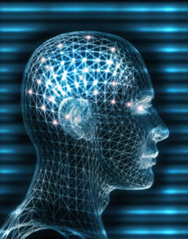
Electroencephalograms (EEGs)
Electroencephalograms (EEGs) are used in a wide range of clinical settings to record electrical activity along the scalp.
EEGs are the primary means by which neurologists diagnose brain-related illnesses such as epilepsy and seizures.
Manual review of an EEG by a neurologist is time-consuming and tedious.
A clinical decision support tool that automatically interprets EEGs can reduce time to diagnosis, reduce error and enhance real-time applications such as ICU monitoring.
EEG classification using deep learning:
Deep Belief Network (DBNs)
Stacked denoising Autoencoder (SdA)

Slide 25
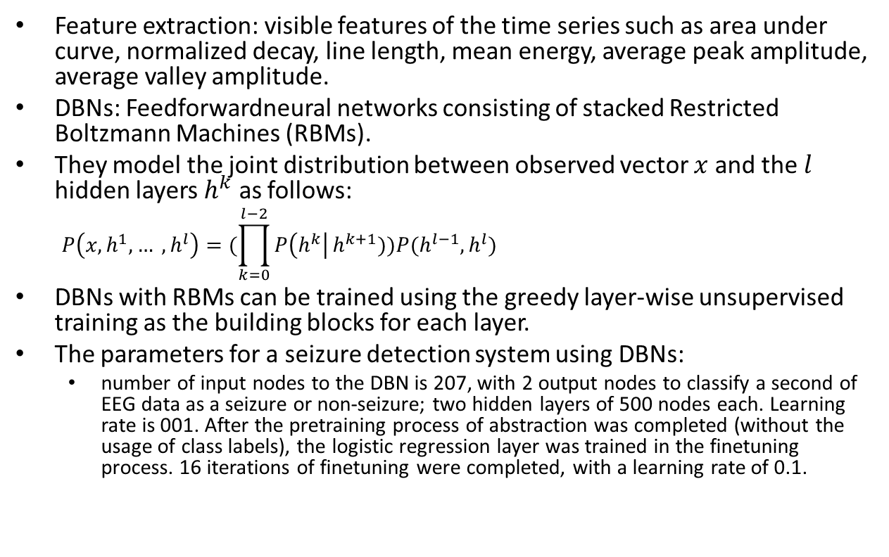
EEG classification using DBNs
Feature extraction: visible features of the time series such as area under curve, normalized decay, line length, mean energy, average peak amplitude, average valley amplitude.
DBNs: Feedforwardneural networks consisting of stacked Restricted Boltzmann Machines (RBMs).
They model the joint distribution between observed vector $x$ and the $l$ hidden layers $h^{k}$ as follows:
$$P\left(x, h^{1},… , h^{l}\right)=(\prod_{k=0}^{l−2}{P\left(h^{k}\right|}h^{k+1}))P(h^{l−1},h^{l})$$
DBNs with RBMs can be trained using the greedy layer-wise unsupervised training as the building blocks for each layer.
The parameters for a seizure detection system using DBNs:
number of input nodes to the DBN is 207, with 2 output nodes to classify a second of EEG data as a seizure or non-seizure; two hidden layers of 500 nodes each. Learning rate is 001. After the pretraining process of abstraction was completed (without the usage of class labels), the logistic regression layer was trained in the finetuning process. 16 iterations of finetuning were completed, with a learning rate of 0.1.

Slide 26
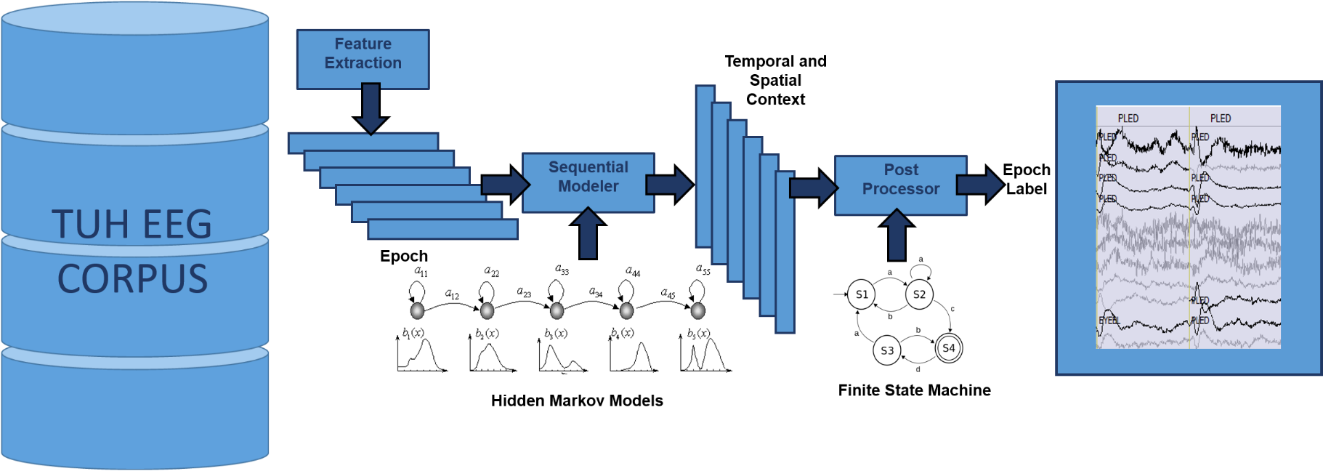
EEG classification using SdAs
AutoEEG is a hybrid system that uses three levels of processing to achieve high performance event detection on clinical data:
P1: hidden Markov models
P2: SdA
P3: Language Model

Slide 27
Summary
Deep recurrent neural networks and deep bidirectional long short-term memory have given the best known results in sequential tasks like speech recognition.
EEG classification using deep learning methods like deep belief network and SdAs introduced.
EEG classification is a sequetional task and to the best of my knowledge RNNs have never been used for this task.
LSTMs seems to be a good candidate for analyzing of EEG signals as :
Their memory decrease the false alarm.
Using CTC for training, we can probably use physicians reports directly without alignment.
Heuristics language model can be replaced by the structure of DBLSTM using RNN Transducer.
Seizure prediction that can alarm much earlier.
Future work:
Replacing SdA by these algorithms respectively: Standard RNN, LSTM, DRNN, DLSTM, DBLSTM.
Developing a seizure prediction tool using DBLSTM.

Slide 28
Brief Bibliography
[1]M. Hermans and B. Schrauwen, “Training and Analyzing Deep Recurrent Neural Networks,” Adv. Neural Inf. Process. Syst., pp. 190–198, 2013.
[2] A. Graves, A. Mohamed, and G. Hinton, “Speech Recognition With Deep Recurrent Neural Networks,” IEEE Int. Conf. Acoust. Speech, Signal Process., no. 3, pp. 6645–6649, 2013.
[3] J. T. Turner, A. Page, T. Mohsenin, and T. Oates, “Deep Belief Networks used on High Resolution Multichannel Electroencephalography Data for Seizure Detection,” AAAI Spring Symp. Ser., no. Bengio, pp. 75–81, 2014.
[4]Y. LeCun, Y. Bengio, and G. Hinton, “Deep learning,” Nature, vol. 521, no. 7553, pp. 436–444, 2015.
[5]Y. Bengio, P. Simard, and P. Frasconi, “Learning Long-Term Dependencies with Gradient Descent is Difficult,” IEEE Trans. Neural Networks, vol. 5, no. 2, pp. 157–166, 1994.
[6]R. Pascanu, T. Mikolov, and Y. Bengio, “On the difficulty of training recurrent neural networks,” in International Conference on Machine Learning, 2013, no. 2, pp. 1310–1318.
[7]S. Hochreiter, Y. Bengio, P. Frasconi, and J. Schmidhuber, “Gradient flow in recurrent nets: the difficulty of learning long-term dependencies,” A F. Guid. to Dyn. Recurr. Networks, pp. 237–243, 2001.
[8]S. Hochreiter, S. Hochreiter, J. Schmidhuber, and J. Schmidhuber, “Long short-term memory.,” Neural Comput., vol. 9, no. 8, pp. 1735–80, 1997.
[9]K. Greff, R. K. Srivastava, J. Koutník, B. R. Steunebrink, and J. Schmidhuber, “LSTM: A Search Space Odyssey,” arXiv, p. 10, 2015.
[10]A. Graves and J. Schmidhuber, “Framewise phoneme classification with bidirectional LSTM networks,” in Proceedings of the International Joint Conference on Neural Networks, 2005, vol. 4, pp. 2047–2052.
[11]A. Graves, S. Fernandez, F. Gomez, and J. Schmidhuber, “Connectionist Temporal Classification : Labelling Unsegmented Sequence Data with Recurrent Neural Networks,” Proc. 23rd Int. Conf. Mach. Learn., pp. 369–376, 2006.
[12]A. Graves, “Sequence transduction with recurrent neural networks,” in ICML Representation Learning Workshop, 2012
[13]G. E. Hinton and R. R. Salakhutdinov, “Reducing the Dimensionality of Data with Neural Networks,” Science (80-. )., vol. 313, no. 5786, pp. 504–507, 2006.
[14]Y. Bengio, P. Lamblin, D. Popovici, and H. Larochelle, “Greedy Layer-Wise Training of Deep Networks,” Adv. Neural Inf. Process. Syst., vol. 19, no. 1, p. 153, 2007.

